Slide 1

SINGLE LAYER PERCEPTRON DECISION TREE
A Powerful Open-Source Data Analytics Platform
By
YUVAPRIYA S
2022503552

Slide 2
Introduction to KNIME
KNIME (Konstanz Information Miner) is an open-source platform for data analytics, reporting, and integration.
Enables users to create data flows (pipelines), execute analysis, and model data without deep programming skills.
Supports visual programming with an intuitive drag-and-drop interface.

Slide 3
KNIME Features
Data Integration: Connects to databases, flat files, and cloud services.
Data Preprocessing: Cleaning, filtering, and transforming data.
Analytics: Machine learning, statistical, and deep learning algorithms.
Reporting & Visualization: Data visualization and interactive reports.
Extension Support: Community-contributed extensions for specialized tasks.

Slide 4
How Does KNIME Work?
Drag-and-Drop Workflow:
Workflows built by connecting nodes for various data processing tasks.
Nodes represent operations like reading files, applying filters, and creating models.
Customizable workflows that can be saved, reused, and shared.
Integration with External Tools:
Supports Python, R, SQL, and ML frameworks (TensorFlow, H2O).

Slide 5
Advantages of KNIME
Open Source: Free to use.
User-Friendly: Intuitive interface.
Flexibility: Integrates with Python, R, Java.
Scalability: Supports enterprise-level analysis.
Extensibility: Thousands of extensions.
Strong Community: Active support and documentation.

Slide 6
KNIME vs. Similar Tools
KNIME vs. RapidMiner: KNIME offers more control, while RapidMiner is more polished for business users.
KNIME vs. SAS: KNIME is free; SAS is commercial and used for statistical analysis.
KNIME vs. Python/R: KNIME is no-code; Python/R offers more customization.

Slide 7
Benefits of KNIME
Cost-Effective: Free and open-source.
Community & Extensibility: Large repository of plugins and integrations.
Ease of Use: Drag-and-drop interface.
Scalability: Suitable for small to enterprise-level projects.

Slide 8
Challenges and Limitations
Learning Curve: Large number of nodes and options can be overwhelming.
Performance: Can be slow with large datasets.
Dependency on Extensions: Some advanced features require additional plugins.

Slide 9
Why KNIME?
Powerful & Comprehensive: End-to-end solution from data prep to deployment.
Customization: Allows integration with Python, R.
Scalability: Supports big data frameworks (Spark, Hadoop).
Cost-Effective: Open-source, free alternative to expensive tools.

Slide 10
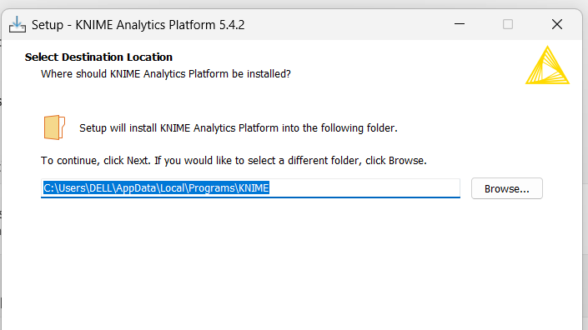

Slide 11
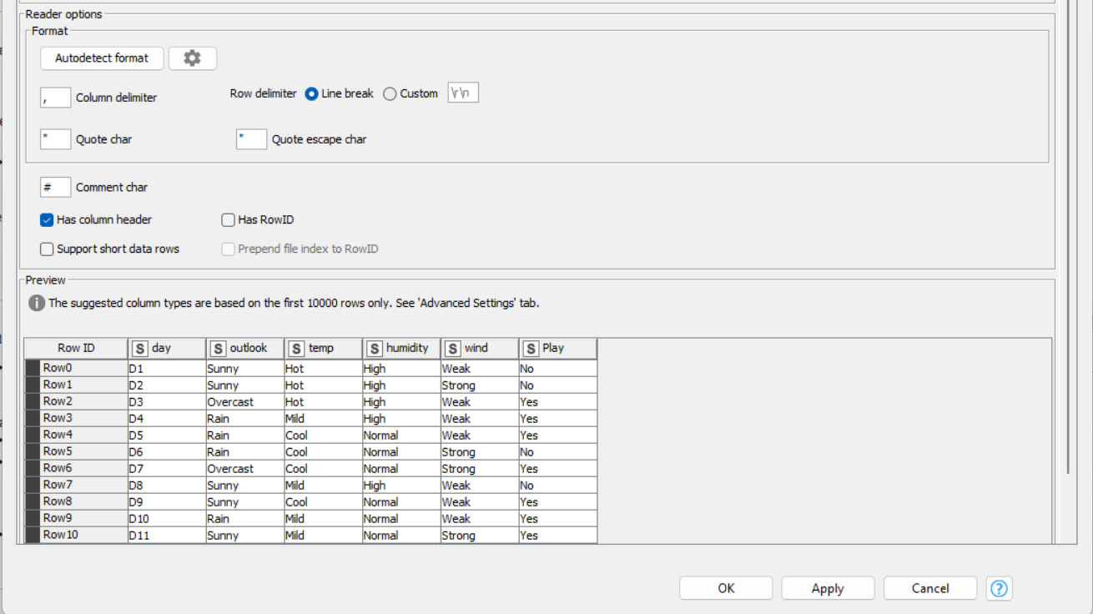

Slide 12
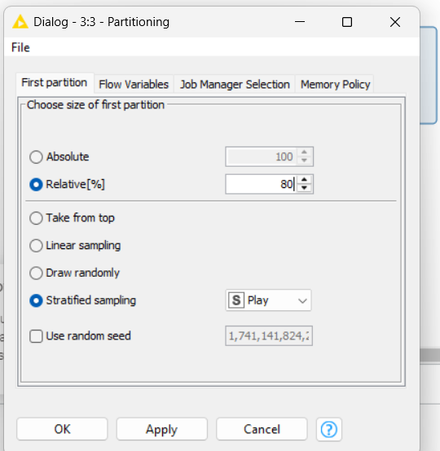

Slide 13
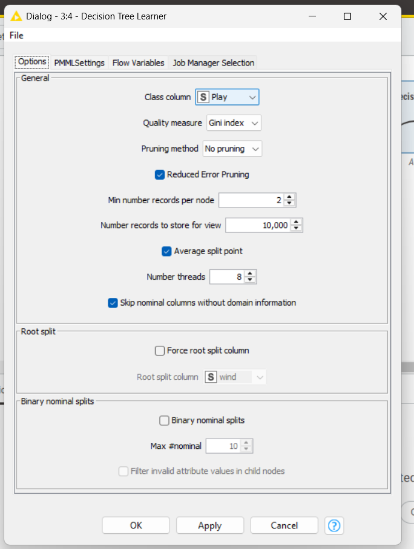

Slide 14
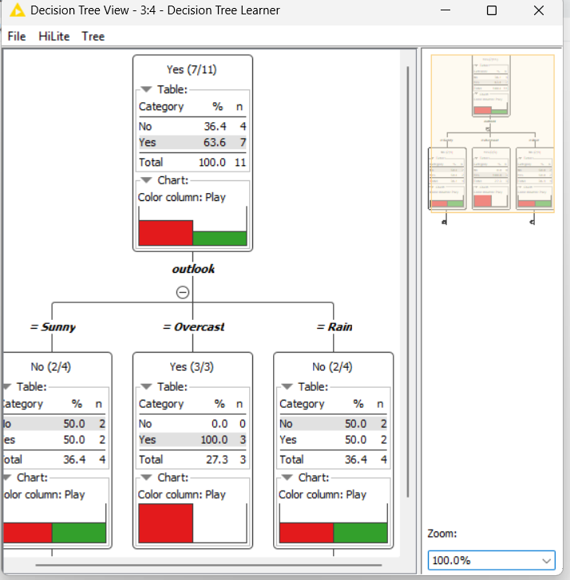

Slide 15
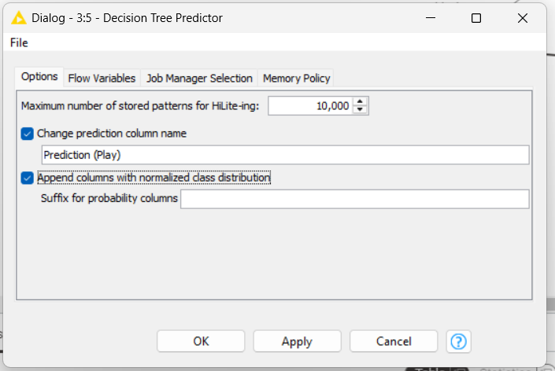

Slide 16
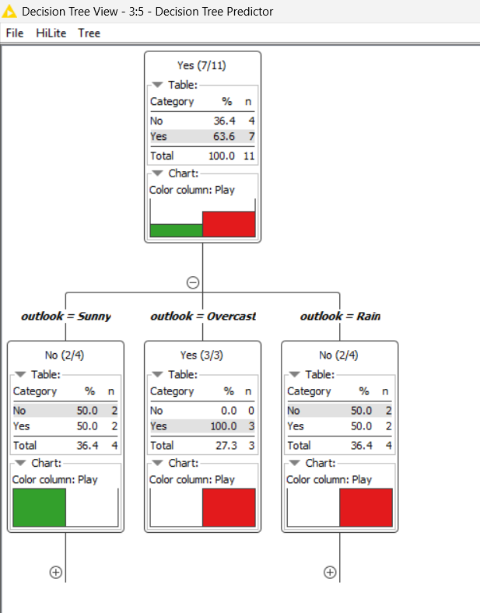

Slide 17
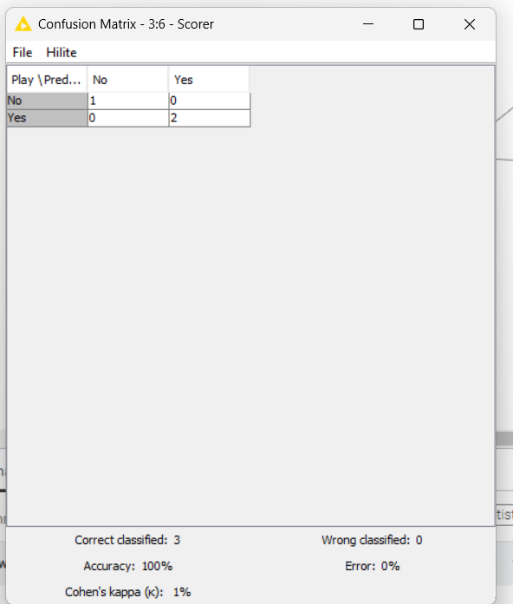

Slide 18
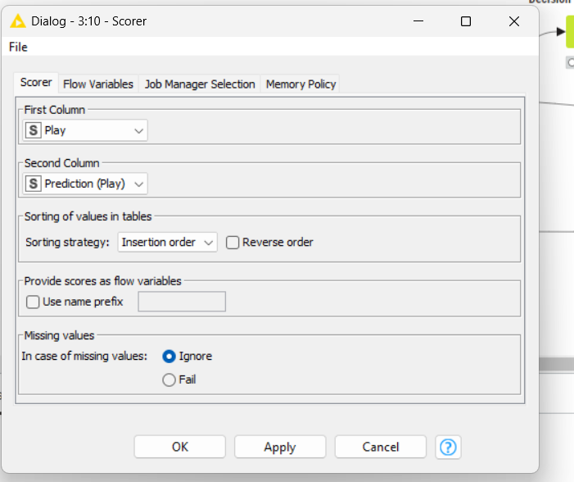

Slide 19
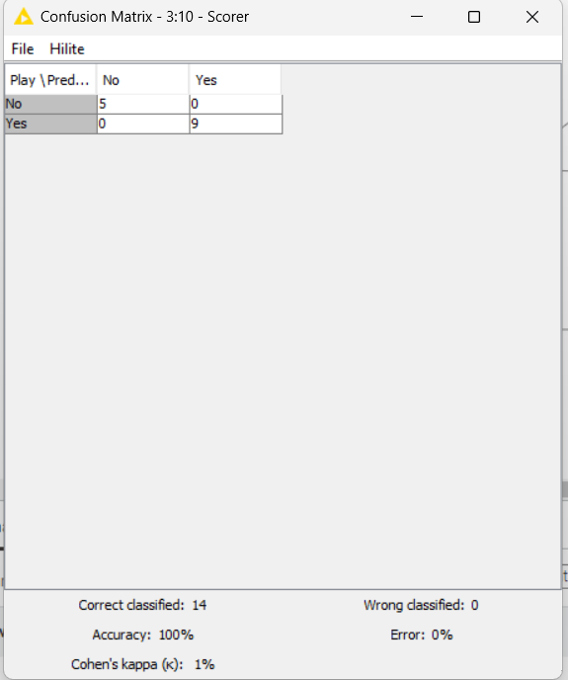

Slide 20
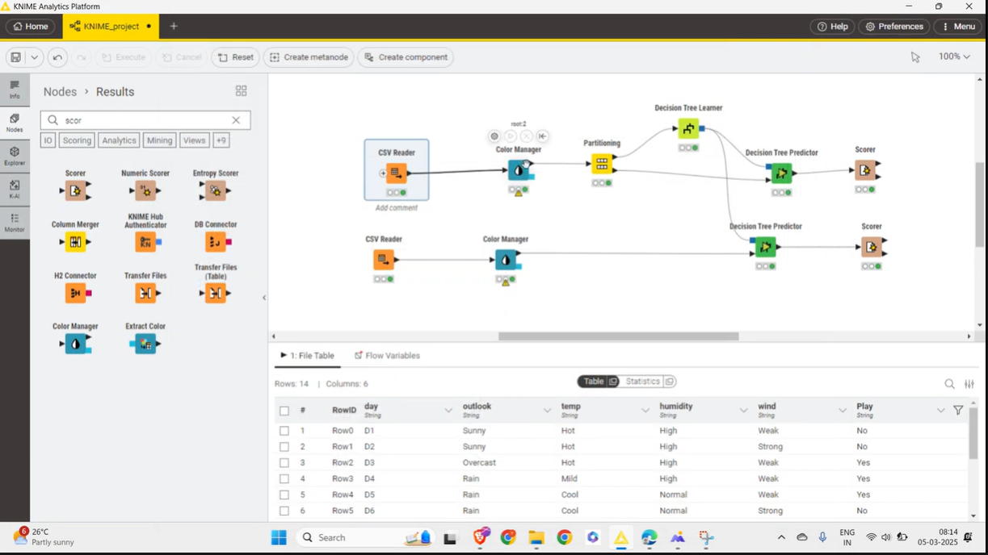

Slide 21
Demo link
Single layer perceptron using logistic regression
https://drive.google.com/file/d/1sdq9Ii0yoT4K2p-i0CRadywUS7EAUgsa/view?usp=sharing
Decision tree
https://drive.google.com/file/d/16UPZb0Br8vlgbP972CExCmpLrHzKJHnk/view?usp=sharing

Slide 22
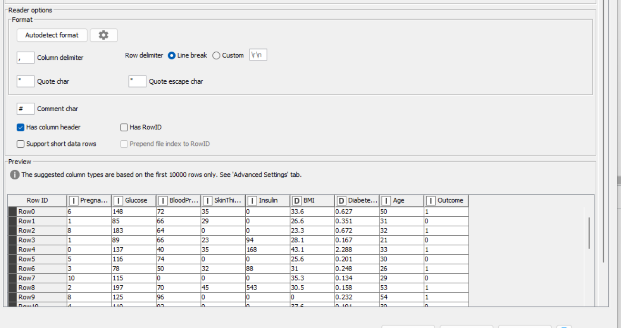

Slide 23
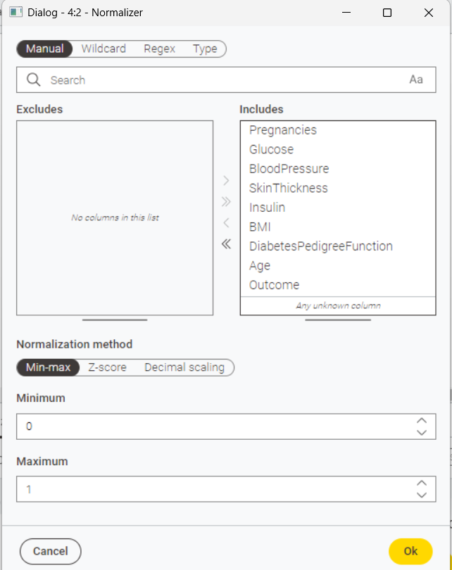

Slide 24
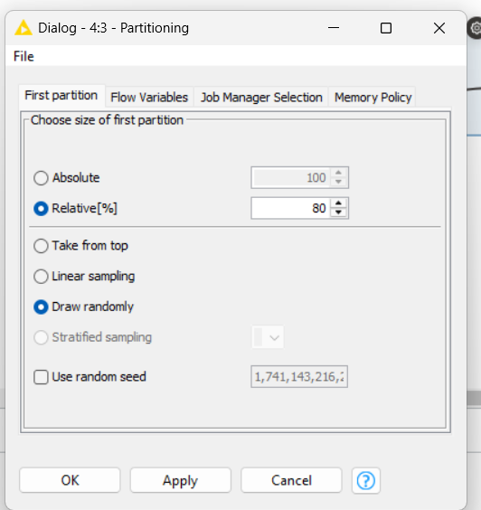

Slide 25
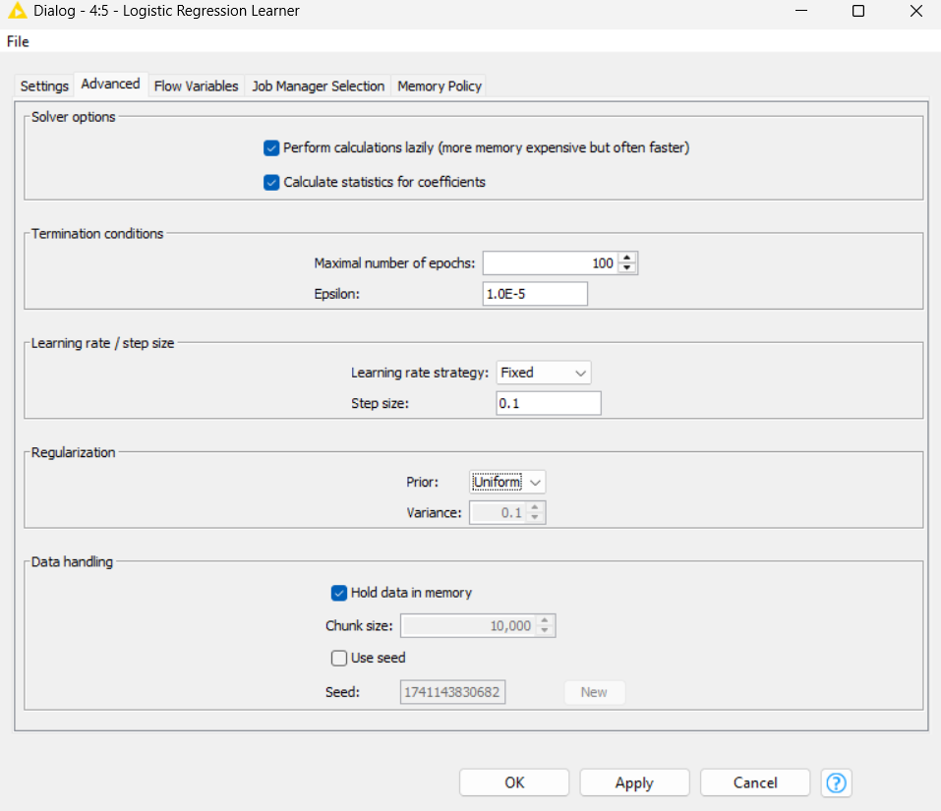

Slide 26
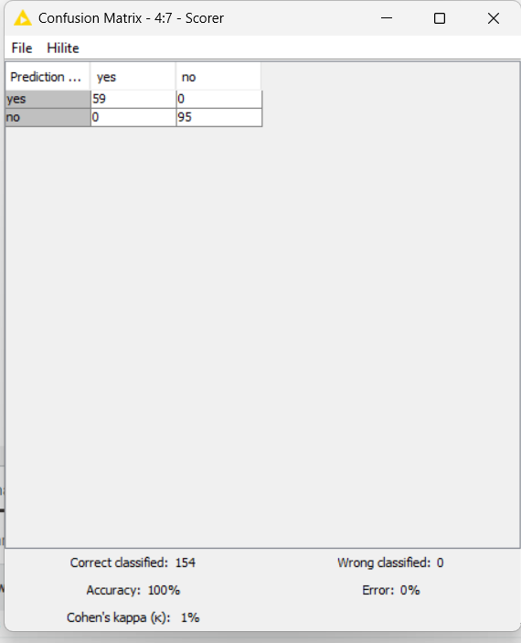

Slide 27
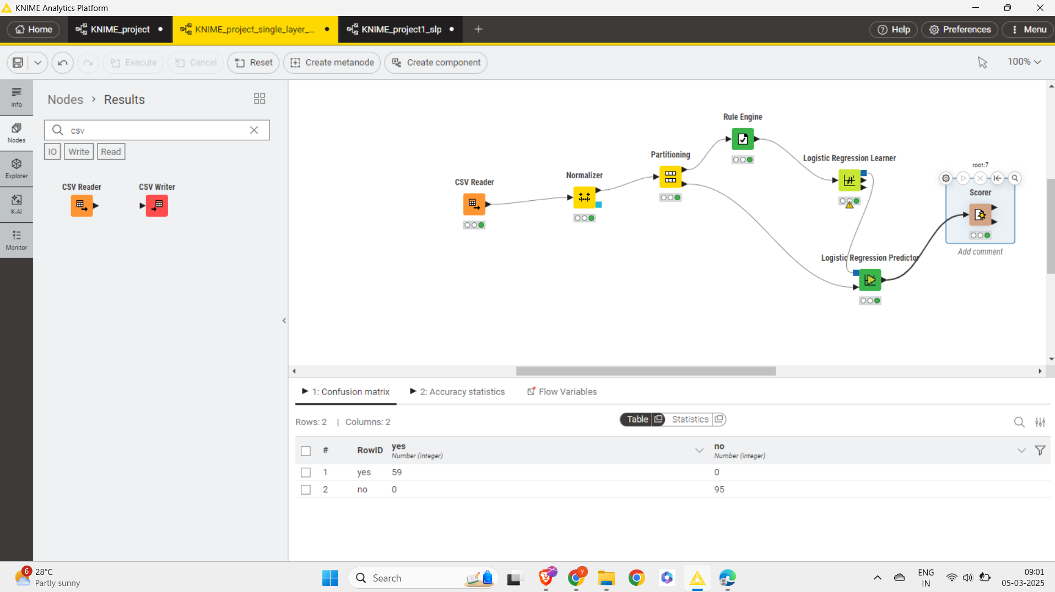

Slide 28
Thank you
By Yuvapriya S
2022503552

